Slide 1
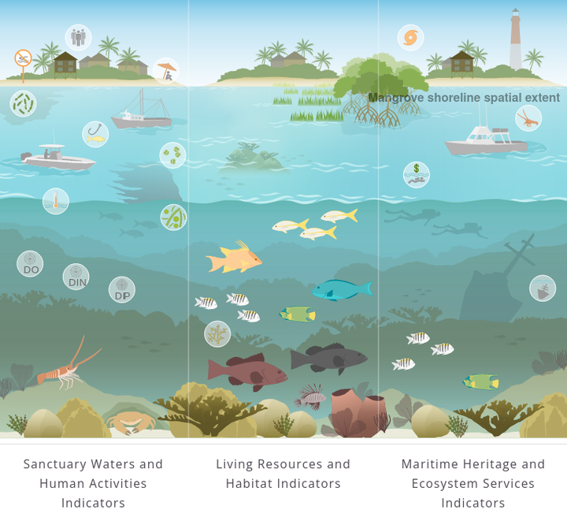
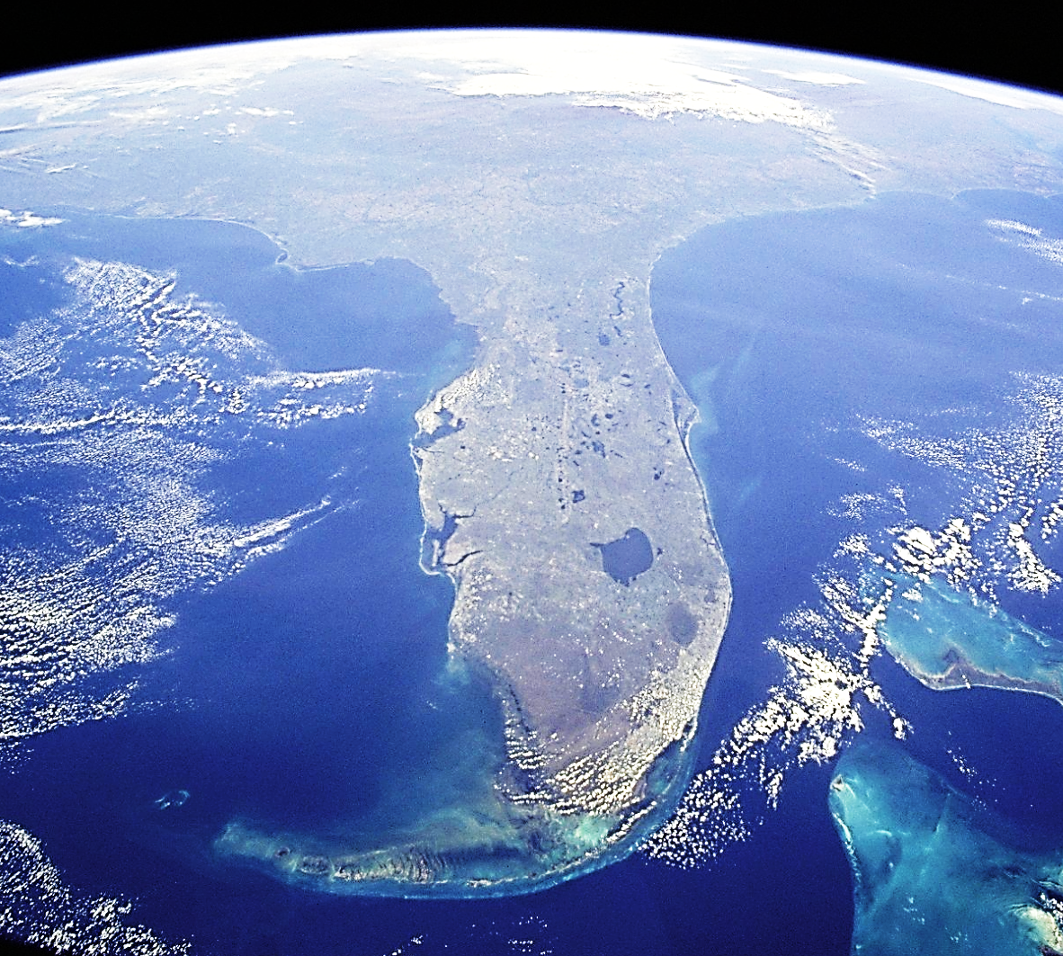









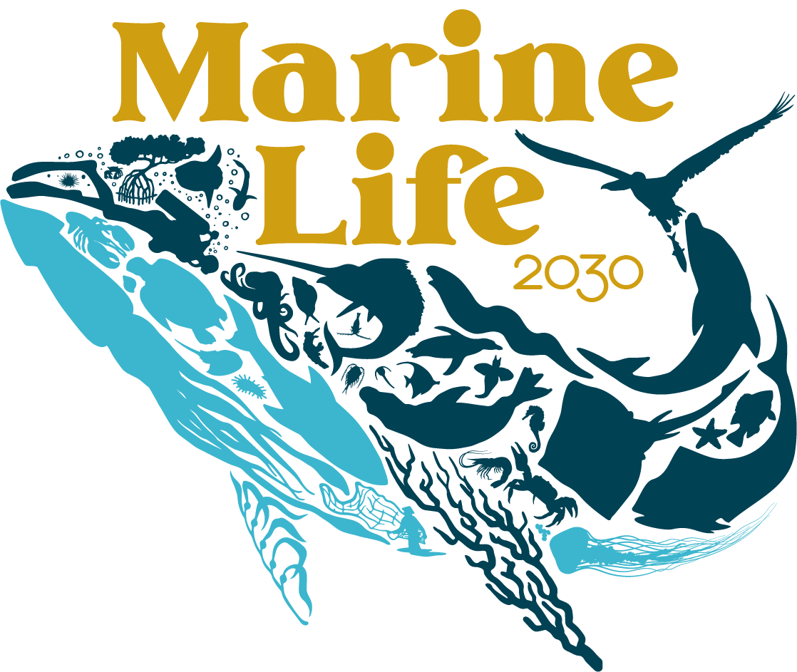











Galaxy
The Southeast US Marine Biodiversity Observation Network (MBON):
Toward Operational Marine Life Data for Conservation and Sustainability
(An MBON Team Leader Proposal)
F. Muller-Karger
D. Otis, T. Murray, D. Rueda,
M. Kavanaugh, J. Trinanes,
J. Brenner, C. Simoniello,
J. Dorton; E. Montes, C. Kelble, L. Thompson, N. Hammerschlag, L. McEachron, B. Best,
K. Montenero, M. Roffer,
S. Gittings; A. Bruckner,
J. Brown, A. Benson
Design and data compilation: Kelly Montenero
Artwork: Amanda Dillon
Technical implementation: Ben Best, Jai Ranganathan, Jennifer Brown

Slide 2
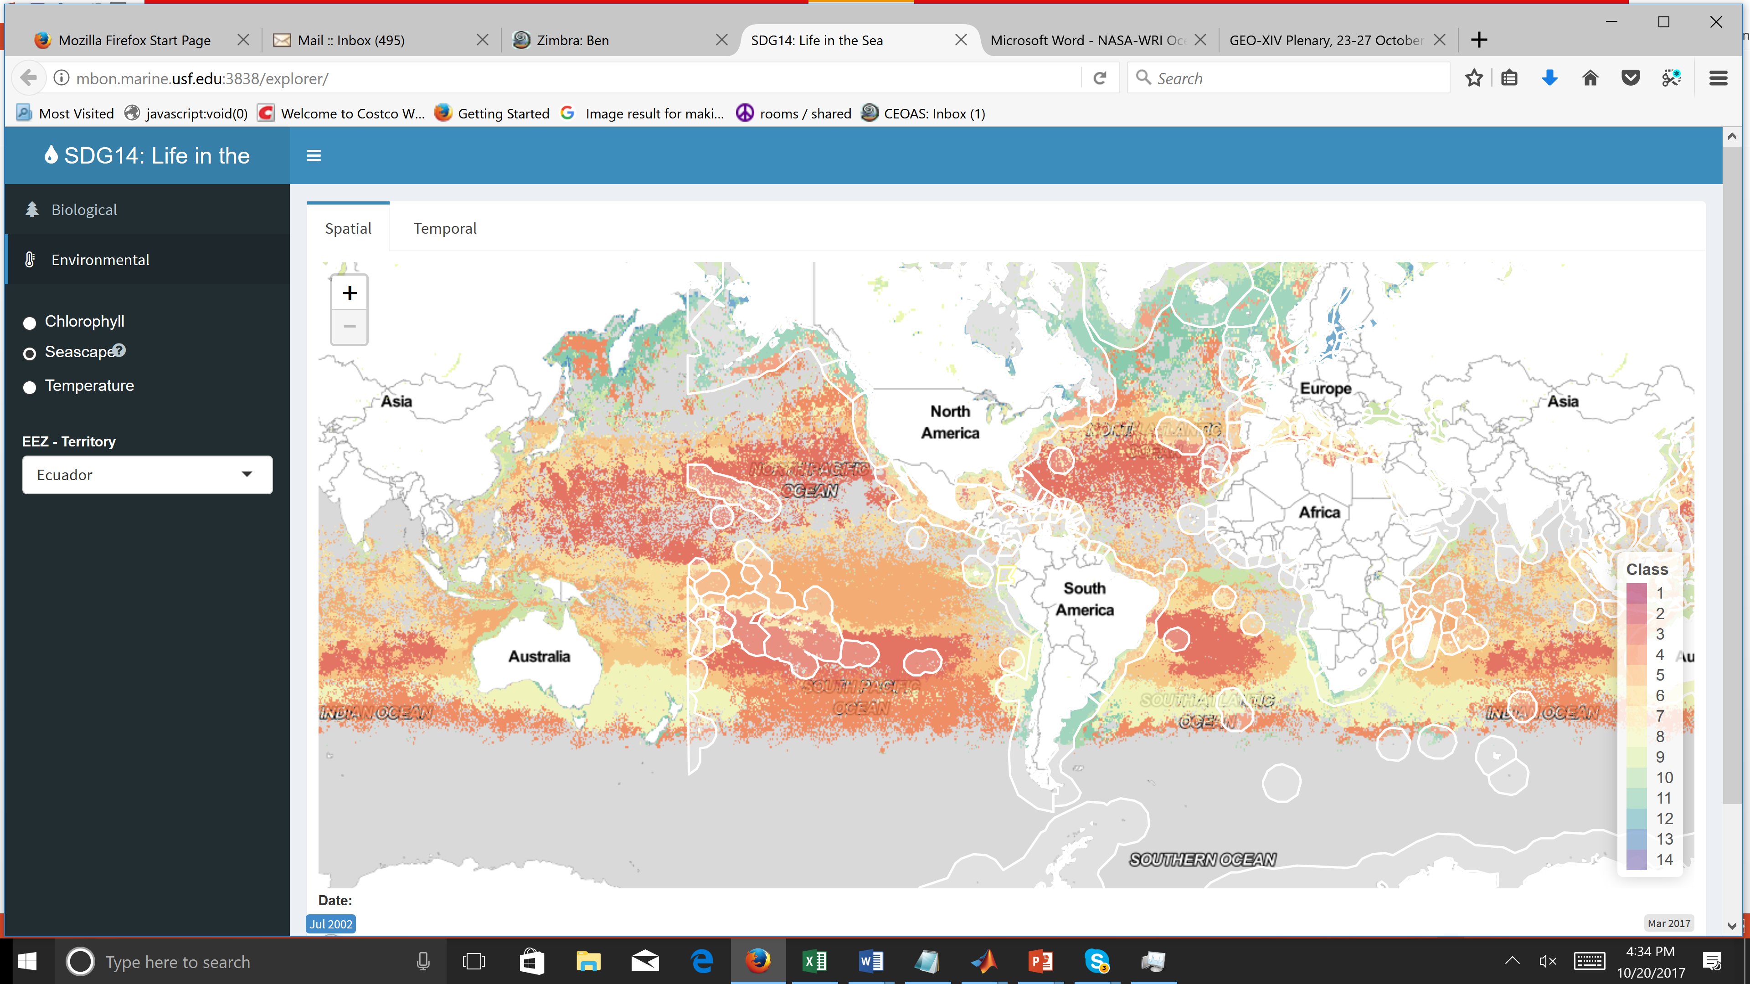
Purpose
Serve as a regional collaboration hub of the IOOS/GOOS to address needs for marine biodiversity information:
Gulf of Mexico and southeast US
International

Slide 3
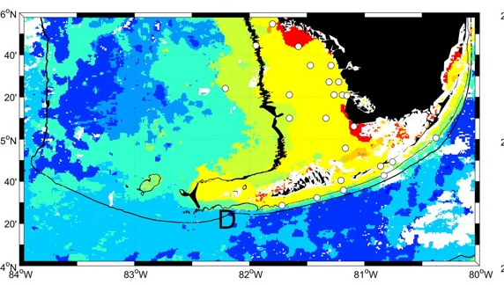
Objectives
1.) Co-design biodiversity monitoring and assessment
- Ecosystem services
- Context: long-term change, human uses, management
2.) Converge on subsets of Essential Ocean Variables (EOVs) and Essential Biodiversity Variables (EBVs) for applications
3.) Contribute to protocols for distribution of products
4.) Serve as MBON Team Leader

Slide 4
Justification
Need to quantify change in biodiversity, biogeographic patterns
Inform research, applications (MBON, Marine Life 2030, SDG…)
Address requirements of Sanctuaries, other State/Federal entities
Integrate in situ and remote sensing observations
Lead change in integrating biology into coastal and ocean monitoring (standardized approaches and shared information)

Slide 5
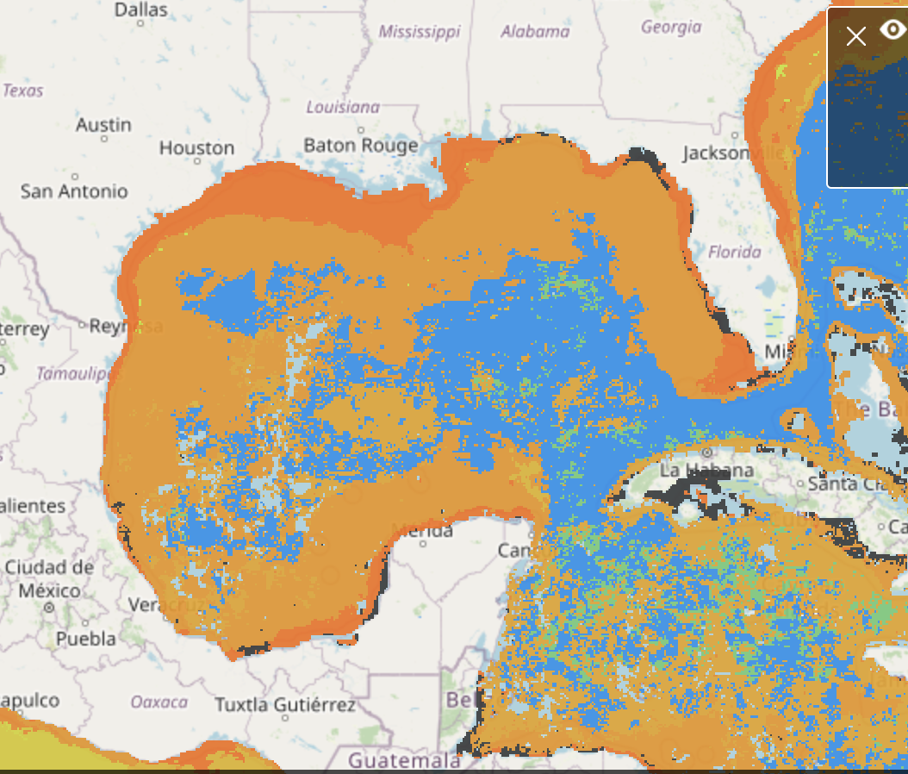
Approach
Work with users across two IOOS Regional Associations
(Southeast Coastal Ocean Observing Regional Association: SECOORA
Gulf of Mexico Coastal Ocean Observing System/GCOOS)
Specifically: FKNMS, FGBNMS, State of Florida FWC and DEP
Leverage existing national observing, data analysis, and data management programs (in situ, remote sensing)
Close collaboration with OBIS, IOOS DMAC
Facilitate national, international collaborations
use MBON as a community of practice
Utility case studies

Slide 6
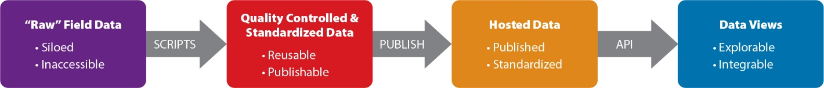
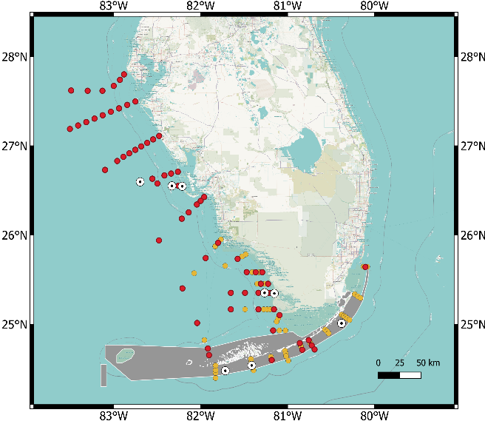
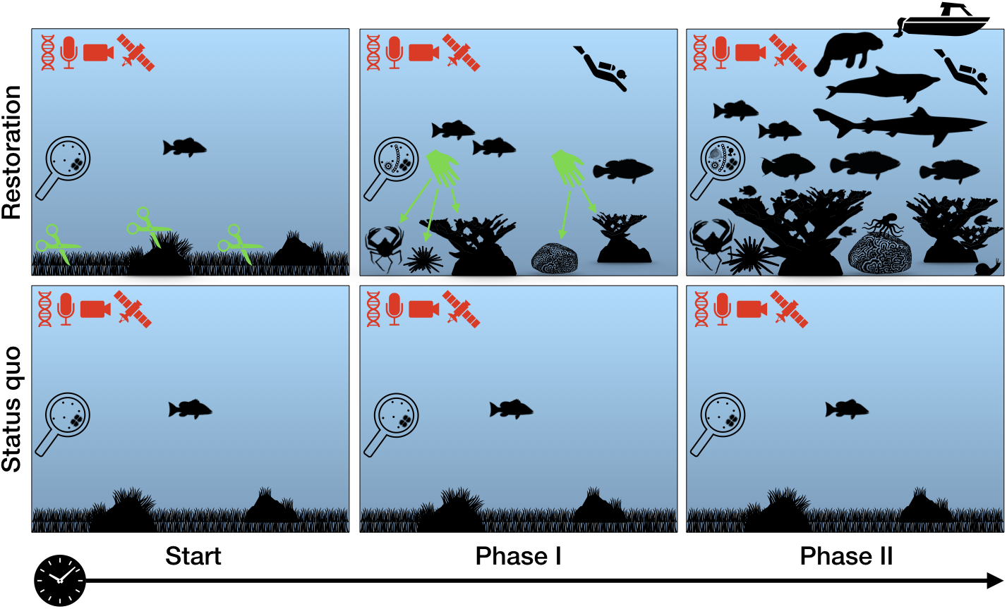
Co-design data flow with management users
MBON Data Flow to promote data, metadata standards. From Benson et al., 2021.
2. Build/analyze subsets of EOVs, EBVs, indicators:
Assess biodiversity, abundance, distribution of organisms
eDNA, acoustics, soundscapes, traditional sampling
Understand marine biogeography using remote sensing
Identify distribution and biodiversity hotspots
3. Interpret/publish biodiversity data (environmental, biology change)
NOAA MBON cruises (every 2 months)

Slide 7
4. Advance ‘webinization’ of MBON products
Evolve open-source infographics
and synthesis applications
Collaboration with stakeholders and
IEA programs
Sanctuary Watch
EcoQuants
NESDIS/CoastWatch
Florida Fish and Wildlife Research Institute
Office of National Marine Sanctuaries
Climate Program Office / NOAA
IOOS / IOOS RAs
Ocean Decade / Marine Life 2030, others
MBON / GEO BON
Apps:
“Infographiq ”
SeascapR
OceanViewer (NESDIS/CoastWatch)
OBIS
Dashboards, storymaps, narratives
Online ‘webenized’ product developed jointly between the IEA and MBON
Earth observation layers (e.g., Seascapes, temperature, chlorophyll-a, etc.) are combined with ecosystem habitat maps. These are linked to an ‘infographic’ representing key or foundational species in a habitat. These would be linked to live data services via ERDDAP. Graphics or tabular data would be displayed or downloaded when clicking on a variable or a species for an area, such as a Marine Protected Area. Axes are dynamic. Thresholds could be adjusted by a user for example to issue email alerts when a threshold is exceeded.

Slide 8

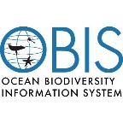
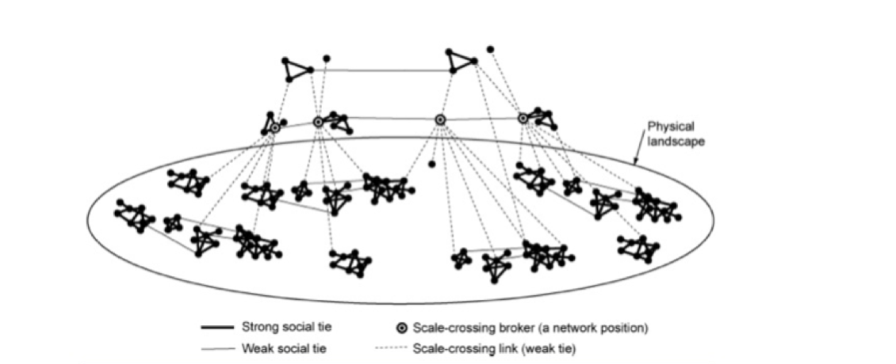
5. Engaging Users: National/Regional
GCOOS and SECOORA stakeholder workshops
Link with:
-NOAA Climate Program Office
Sanctuary Climate Indicators Task Force
-ONMS and Sanctuary personnel
-State of Florida / other states
SECOORA brings C. Ellis (social scientist) for facilitation
GCOOS provides Geographical Information System expertise
Year 1: two workshops
Y2-5: one meeting in each region each year

Slide 9




















5. Engaging Users: International
MBON Secretariats
AIR Centre / Azores (Portugal):
- Joana Soares (Exec. Secretary)
- Adriano Lima (Technical / Engineering)
- Isabel Sousa-Pinto, Massa Nakaoka, Frank Muller-Karger (co-chairs)
US IOOS
- Gabrielle Canonico
Asia Pacific (AP) MBON
- Massa Nakaoka
-Take Yamashita
Marine Life 2030
Observing Life in the Oceans for societal benefit
(- INFORMATION FLOW -)
Data integration and dissemination
+ other national,
international data systems
Other Data Providers and Users
National Governments and Organizations
International Organizations
Non Government Organizations
Research Institutions
Citizen Scientists

Slide 10
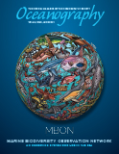
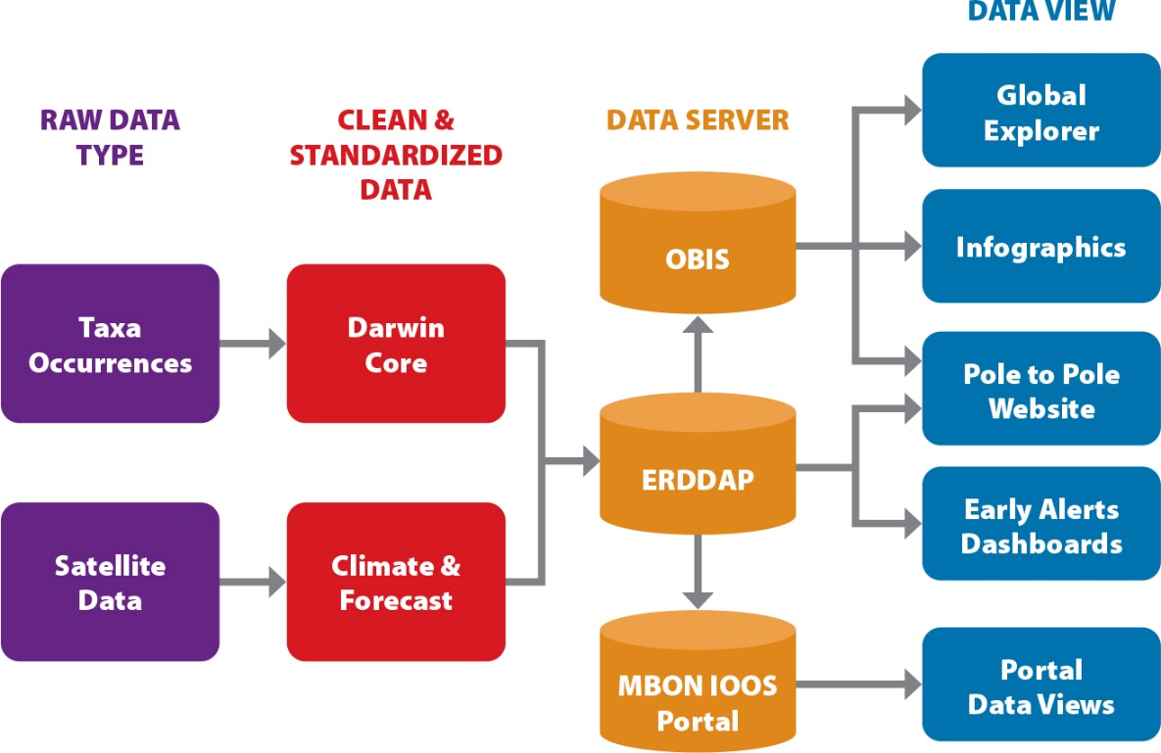
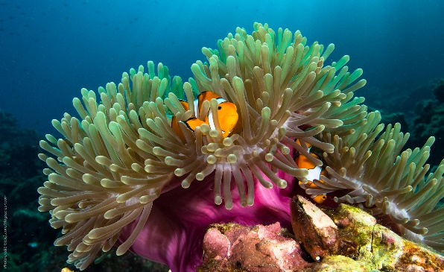
Output:
MBON and OBIS/GBIF collaboration
Mapping data flow: collection to publication
Examples:
Rockfish (California/Pacific)
Reef fish (Florida keys/Atlantic)
Satellite data (early alert dashboards)
Pole to Pole Data Viewer
IOOS MBON Portal
Data Management and Interactive Visualizations
Benson et al., 2021
https://doi.org/10.5670/oceanog.2021.220

Slide 11

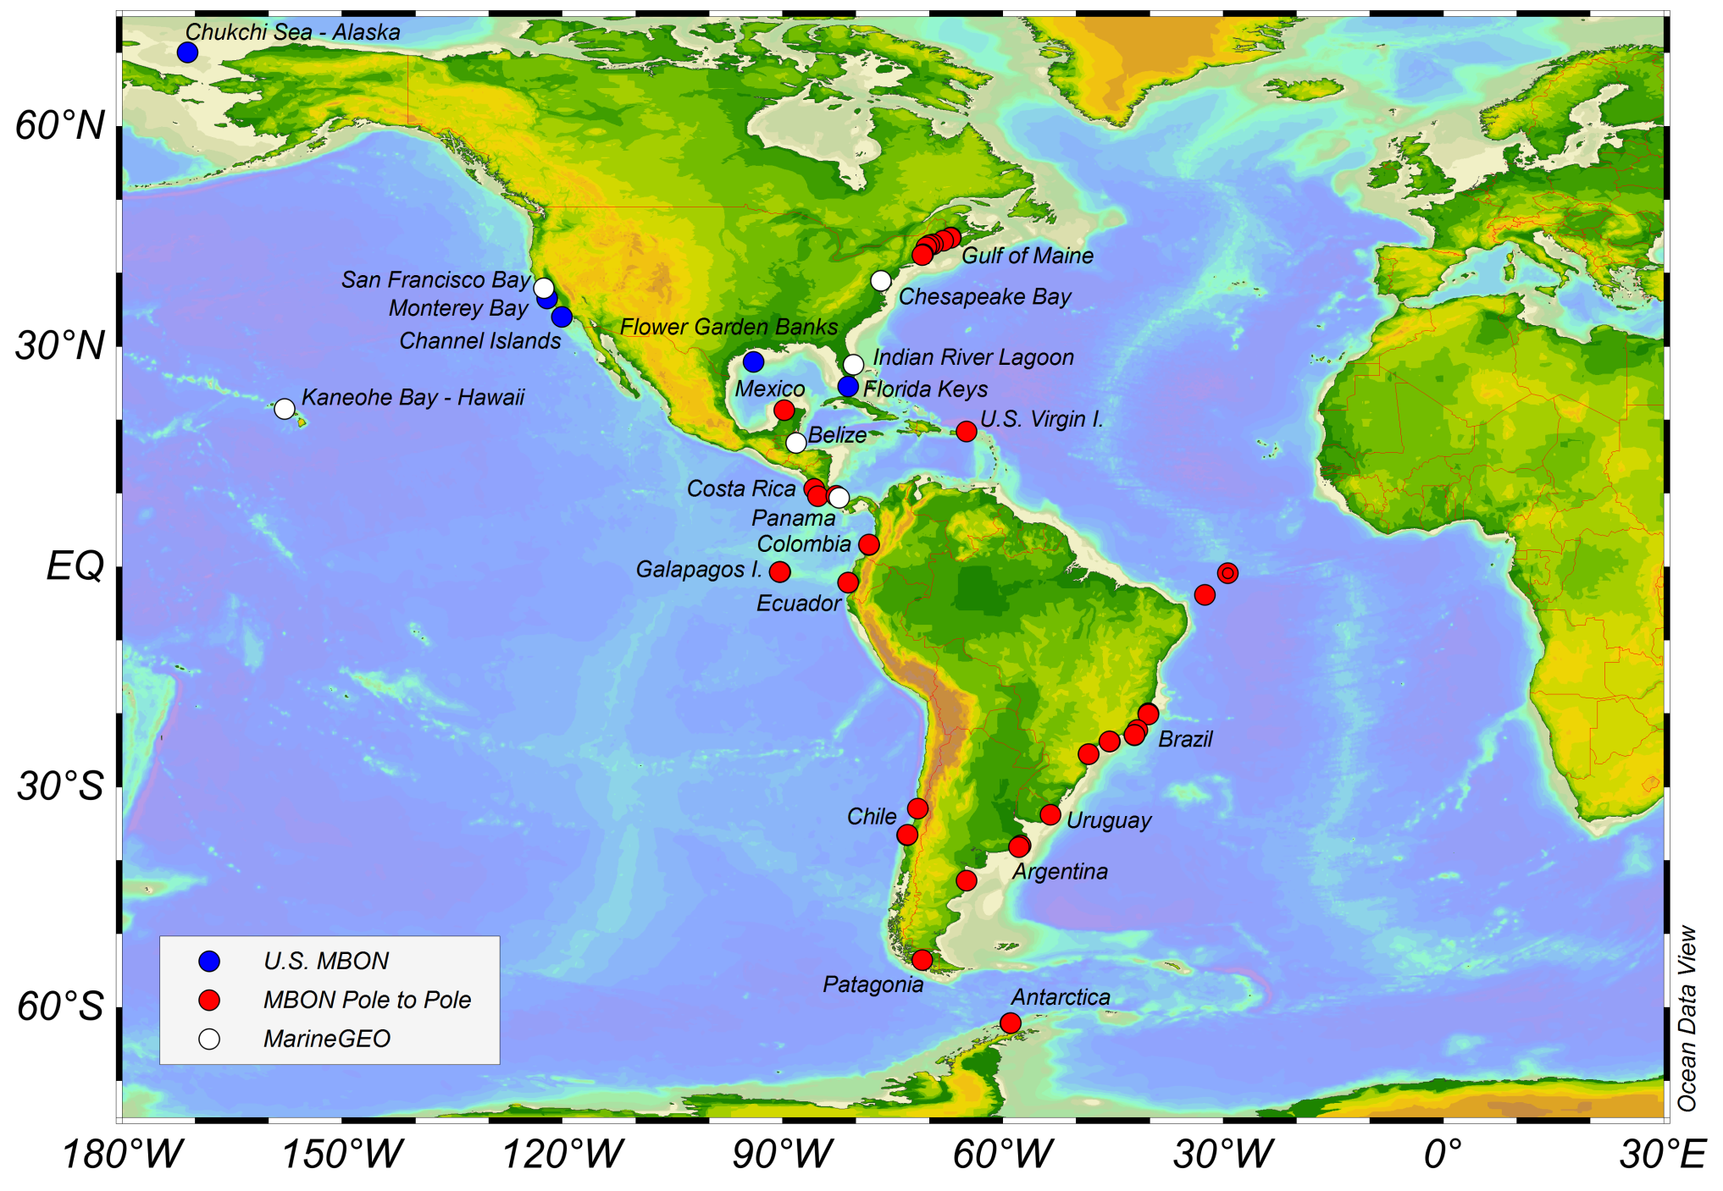
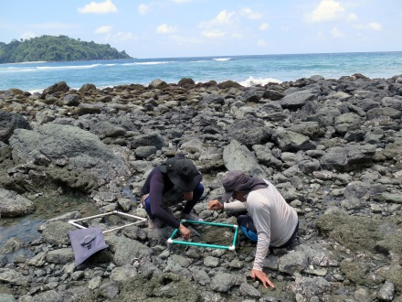
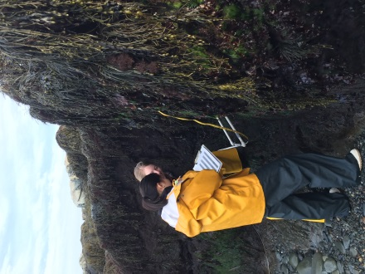
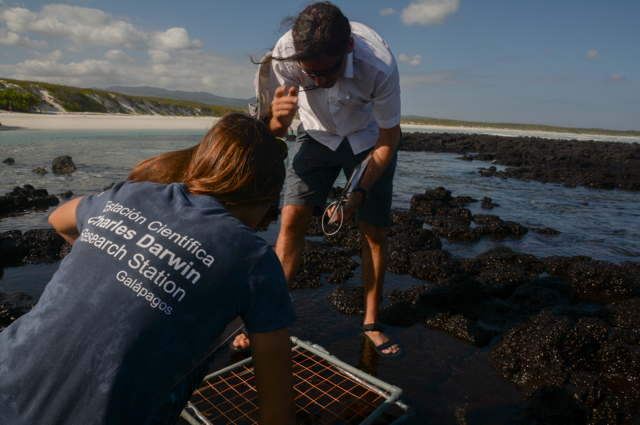
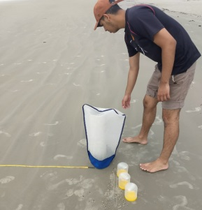
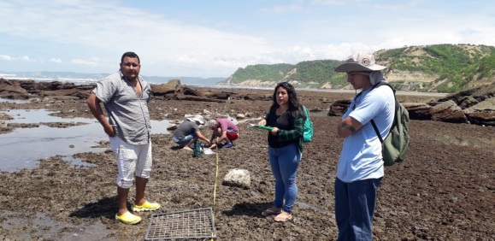
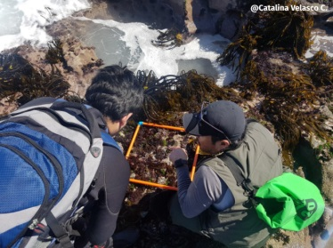
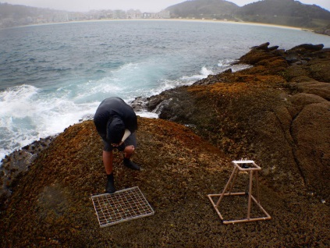
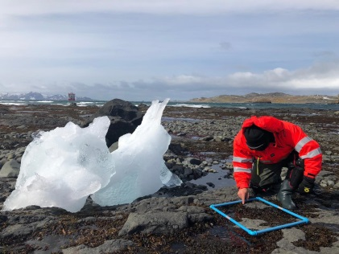
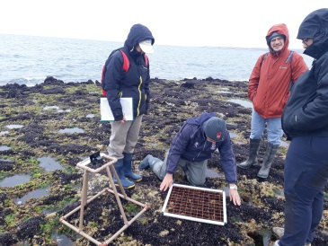
Capacity Building and International Networking
Pole to Pole MBON
Notes:
esta red es loque se ha logrado en 1 an~o

Slide 12
MBON Pole to Pole

Slide 13
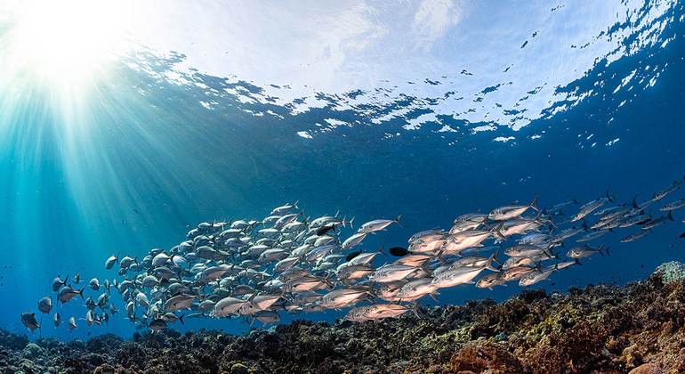
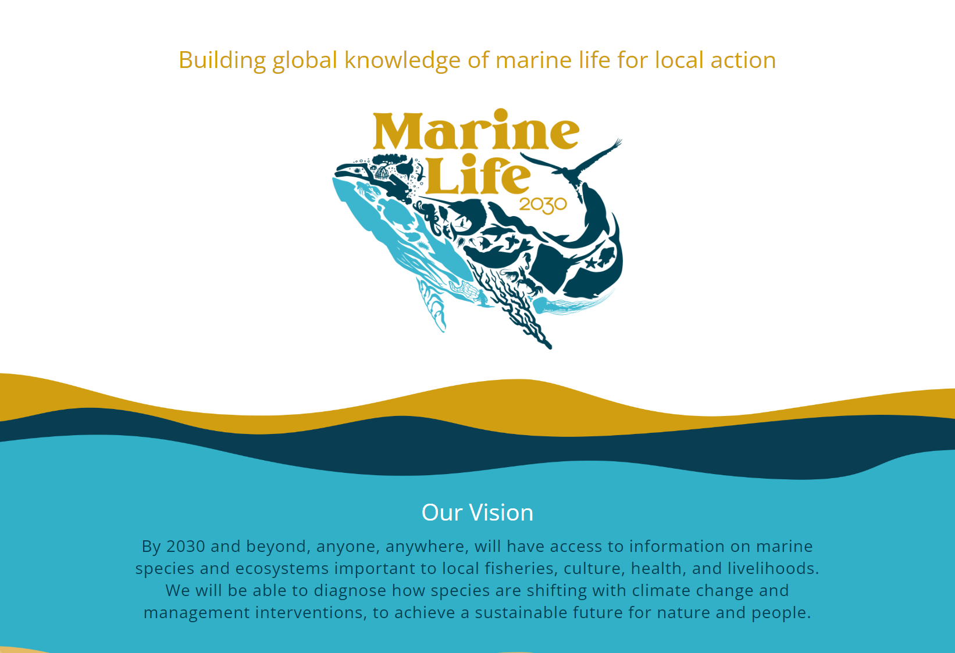

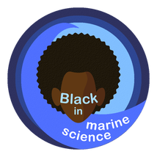

marinelife2030.org
Collaboration with other
Ocean Decade Programs:
OBON, SUPREME, OARS, SMARTNET, DOOS, ECOPS, Challenger150,
Maritime Acoustic Environment,
GOOS Co-Design…

Slide 14
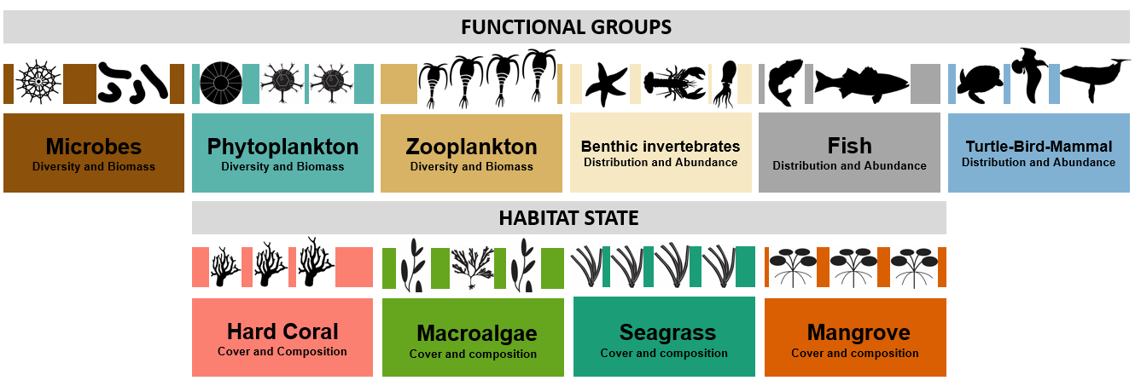
Biology and Ecosystems
Essential Ocean Variables (EOVs)
GOOS Bio-Eco EOV Specification Sheets
Notes:
The Essential Ocean Variables for Biology and Ecology complement EOVs for physics and climate monitoring, and for biogeochemistry monitoring

Slide 15
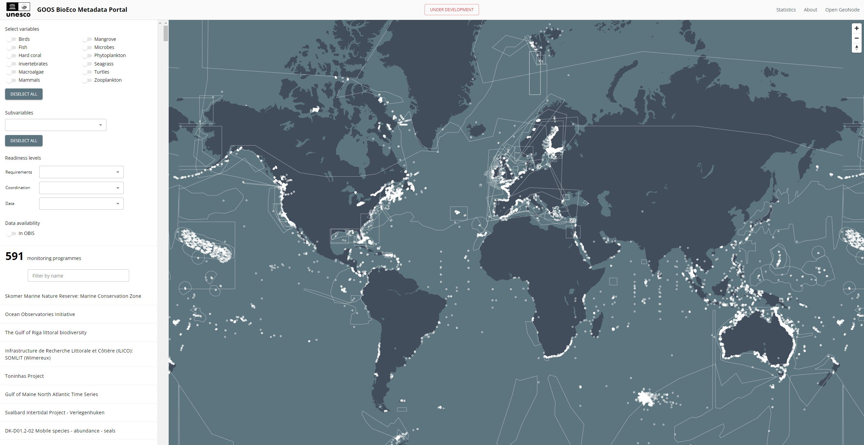
GOOS BioEco Metadata Portal (goosocean.org)
Biology and Ecosystems
We need MBON metadata here
and MBON data in OBIS

Slide 16
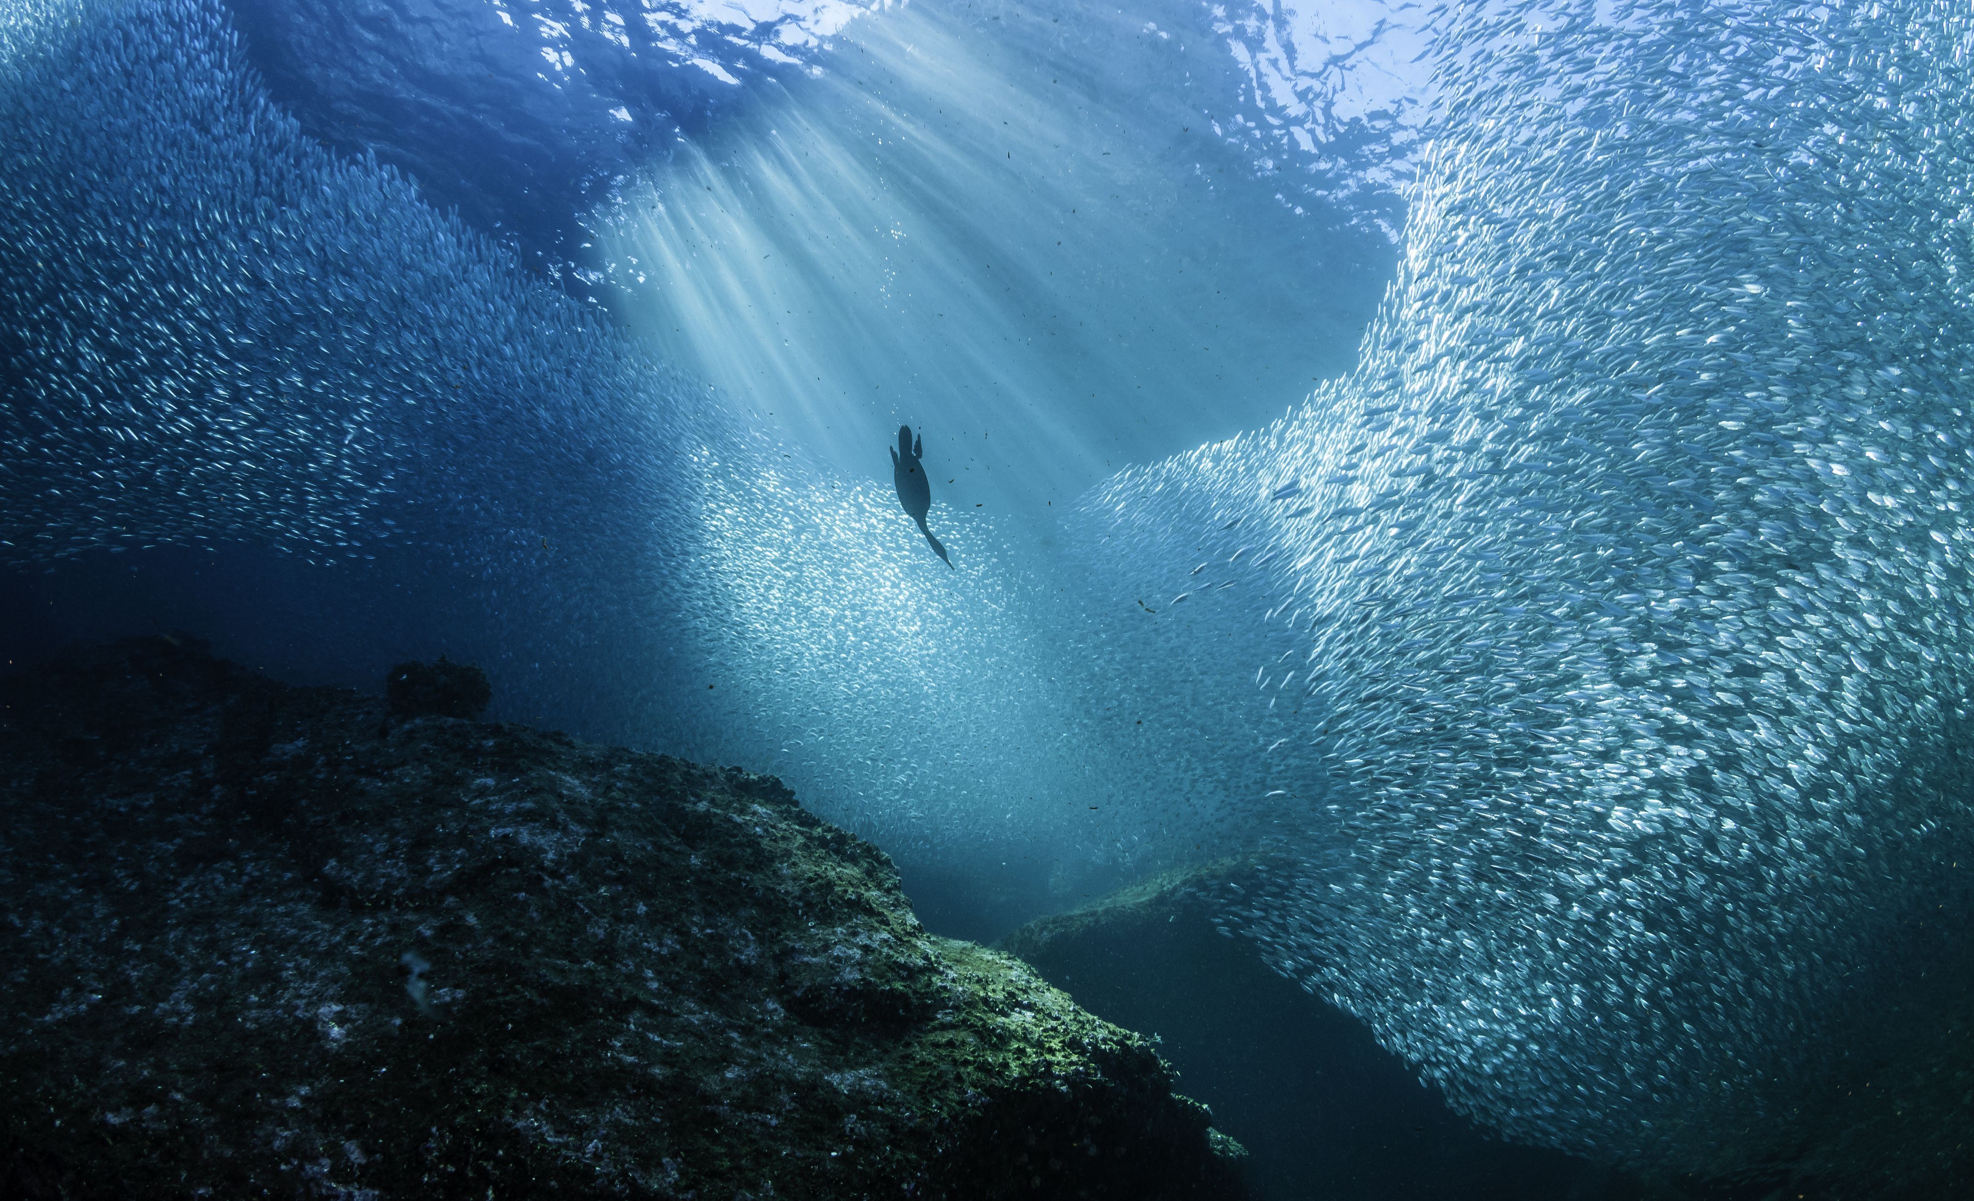



Marine Life 2030 will co-deliver solutions
Convene stakeholders to chart the course together, implementing equitable management for long-term coordination and financing of global marine life observation and applications
Leverage emerging innovation to democratize marine life knowledge, using ‘omics, acoustics, imaging, and AI, and a sequence-based Ocean Biocode of global marine species
Integrate biodiversity into a global ocean observation system by establishing and promoting interoperable biodiversity standards, integrating with other disciplines
Apply enhanced knowledge of marine life to co-develop solutions, informing conservation and sustainable use of marine life by trained stakeholders in every coastal nation
Challenge 2:
Develop solutions
to ecosystem stressors
Challenge 9:
Develop capacity
and equitable access
Challenge 10:
Understand values and services,
humanity’s relationship with ocean
All-Atlantic 2021 Conference | 2-4 June 2021
Notes:
ML2030 will establish the globally coordinated system to deliver actionable, transdisciplinary knowledge of ocean life to those who need it, promoting human well-being, sustainable development, and ocean conservation
Address Ocean Decade Challenges 2, 9, 10

Slide 17
Join us!
marinelife2030.org
Submit your Ocean Decade Action
(Program, Project, Activity, Contribution)
Join as Marine Life 2030 volunteer

Slide 18
Thank you
Frank Muller-Karger
carib@usf.edu
http://marinebon.org
http:/marinelife2030.org

